Slide 1



Case Study On
AIR POLLUTION
By :
ABIJITH K A
25AUR001

Slide 2
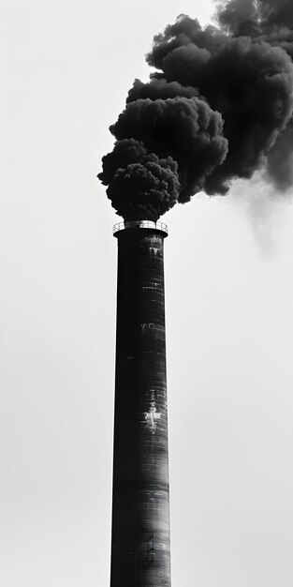
INTRODUCTION
Air pollution in India remains a critical environmental and public health crisis,
with PM2.5 levels exceeding safe limits across the country in 2025, driven by
vehicular emissions, industrial activities, crop residue burning, and construction
dust. Nine of the world's ten most polluted cities are in India, including Delhi,
where winter pollution spikes push AQI into "severe" categories. In January 2025,
cities like Byrnihat recorded PM2.5 averages of 214 µg/m³, far above national
standards of 60 µg/m³.

Slide 3
Major Causes
Vehicular emissions contribute significantly, accounting for up to 67% of pollutants in cities like Delhi, exacerbated by poor fuel quality and traffic congestion. Industrial sources release sulfur dioxide and nitrogen oxides, while biomass burning and stubble burning in northern states add to PM levels; road dust alone contributes 37% in Delhi. In October 2025, Indo-Gangetic Plain cities saw sharp PM2.5 rises due to these baseline emissions.

Slide 4
Health and Economic Impacts
Air pollution causes respiratory diseases, cardiovascular issues, and premature deaths, with lung diseases comprising 39.5% of disability-adjusted life years (DALYs) lost in 2019. It shortens life expectancy by up to 8.2 years in Delhi and affects 544 million people nationwide. Economically, it led to $36.8 billion in losses (1.36% of GDP) in 2019 from morbidity and mortality, with northern states like Uttar Pradesh hit hardest at 2.2% of state GDP.

Slide 5
Prevention
Transportation Choices:
Use public transport, carpool, bike, or walk for short trips to cut vehicle emissions, a leading pollution source. Avoid idling engines and combine errands into fewer trips. Maintain vehicles with proper tire inflation and tune-ups to reduce exhaust.​
Energy Conservation:
Turn off lights and unused appliances to lower power plant emissions from fossil fuels. Opt for energy-efficient appliances, ENERGY STAR products, and insulation. Use fans over air conditioners and refuel cars in the evening during high-ozone seasons.​
Waste and Lawn Practices:
Avoid burning trash, leaves, or garbage, which releases harmful particles; mulch or compost instead. Switch to electric or hand-powered lawn tools over gas ones for lower emissions. Recycle and reuse to cut manufacturing pollution.​
Greening Efforts:
Plant trees, which absorb pollutants like CO2 and release oxygen, aligning with healthy spacing of 400-1,000 per acre. Support afforestation and care for green spaces. Avoid firecrackers, plastics, and smoking to prevent additional releases.​
Broader Actions:
Use chimney filters in homes and factories, low-VOC paints, and cloth bags over plastic. Advocate for clean air programs and check daily forecasts like SmogWatch, especially in areas like Indiana or India. Transition to renewables and EVs where feasible.

Slide 6

Thank You !

